Slide 1
OLMS Content Management System (OCOMS) CBA Registration and Disclosure

Slide 2
Overview
Create Employer records
Send F7 Notices to employers
Receive CBA
Register CBA
Disclose CBA
Management Reports

Slide 3
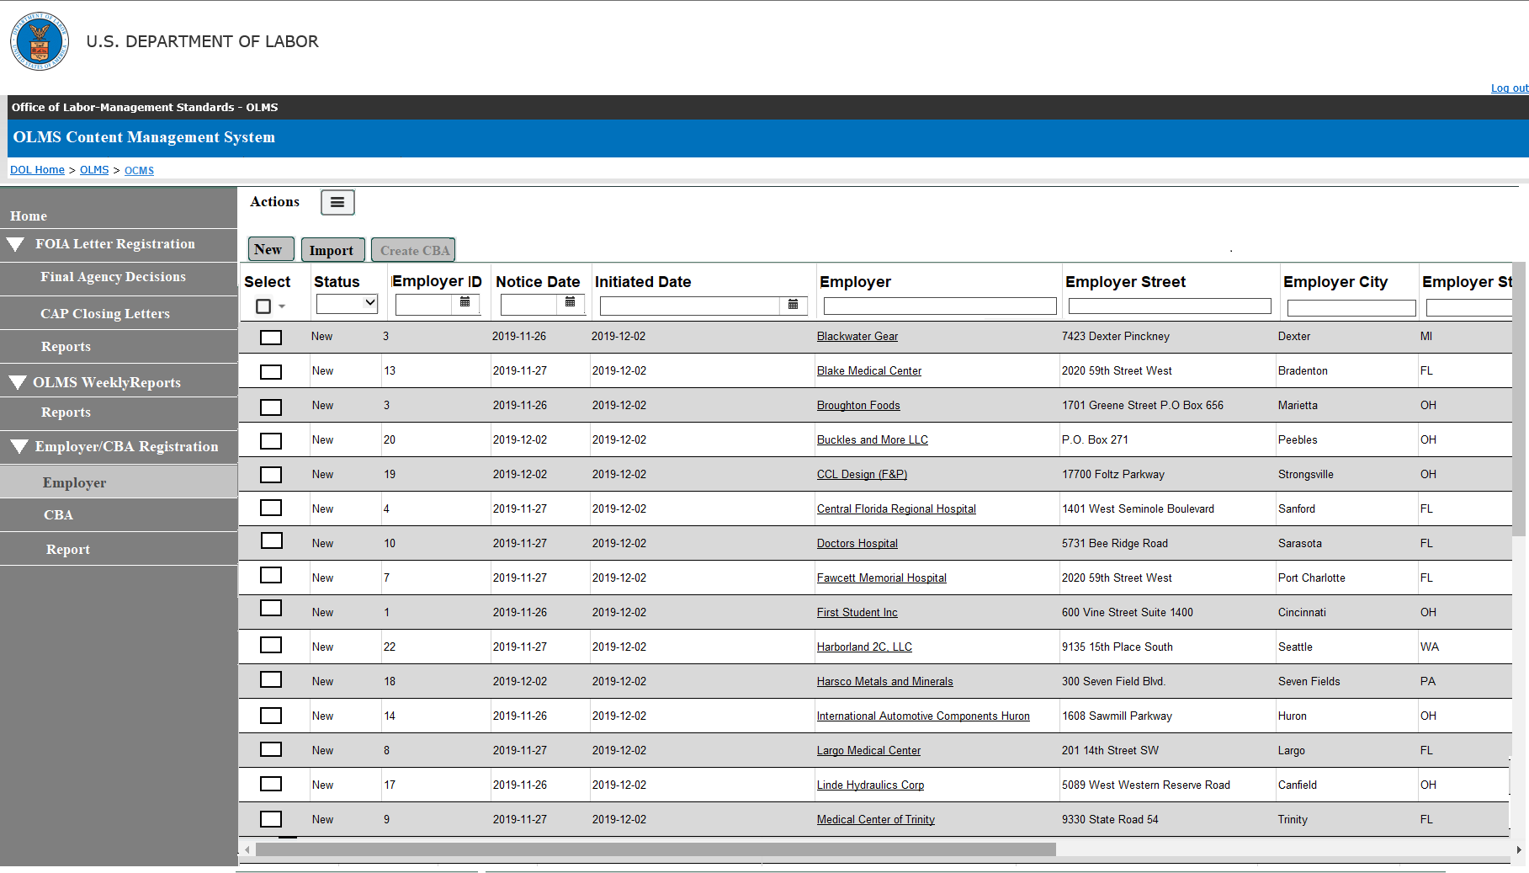
Import - F7 Notices
The CBA registration tool will have an import process to import the Collective Bargaining Notices (F-7) data listed in the CSV file.
The import process will have a duplicate check to identify any duplicate records in the file.
The Duplicate check will use the combination of the following data elements in the CSV.
Employer, employer address, employer representative, union, union address, union representative and the industry
The data has to be exact match to mark it as duplicate
We will look into functionality to check if the same data combination exists in the database (downloaded in the previous months).
Each imported record will get a unique identifier.
The system will set the status of each imported record as New.

Slide 4
Import File
The CSV file needs clean-up to convert some of the data in the format that the system expects
The import file will have the following fields listed:
Affected Location City
Affected Location State
Affected Location ZIP
Expiration Date
Industry
Bargaining Unit Size
Establishment Size
Notice Submitted By
Category
Healthcare Related
Notice Date
Initiated Date
Employer
Employer Street
Employer City
Employer State
Employer ZIP
Employer Representative
Employer Rep Phone
Employer Rep Title
Employer Rep Email
Union Name
Union Local Number
Union Street
Union City
Union State
Union ZIP
Union Rep
Union Rep Phone
Union Rep Title
Union Rep Email
NAICS code listed in the original CSV file will not get imported into the system.
The Union Name, Union Designation and Local Number should be separated to import into the system.

Slide 5
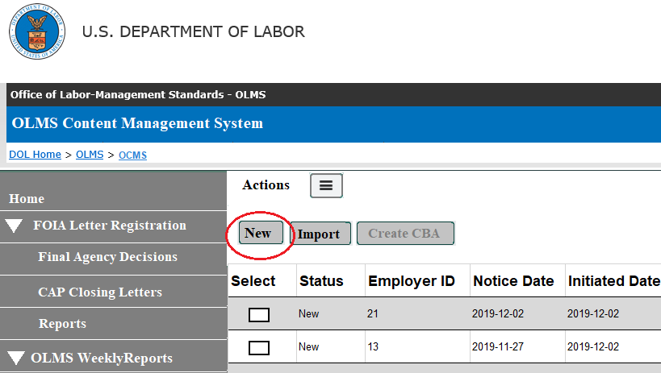
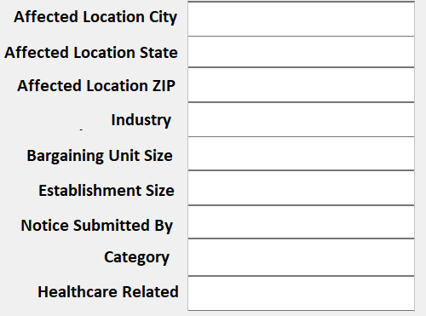
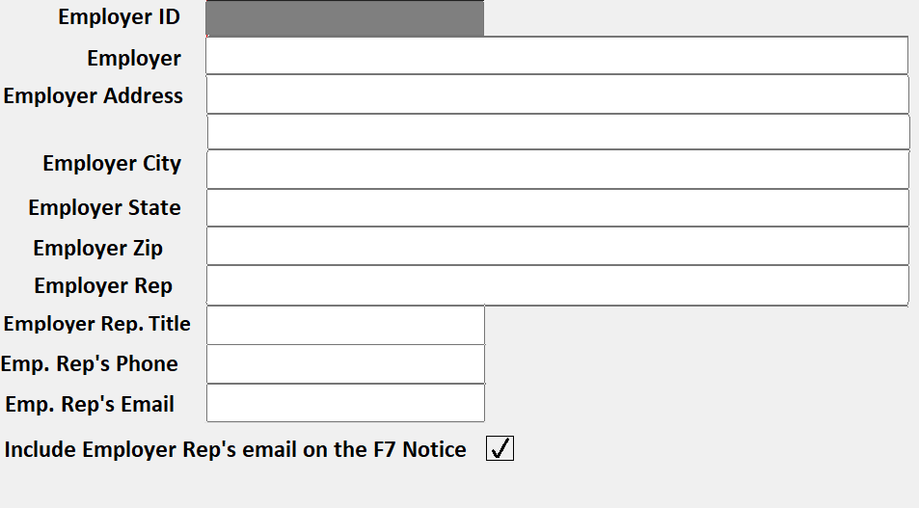
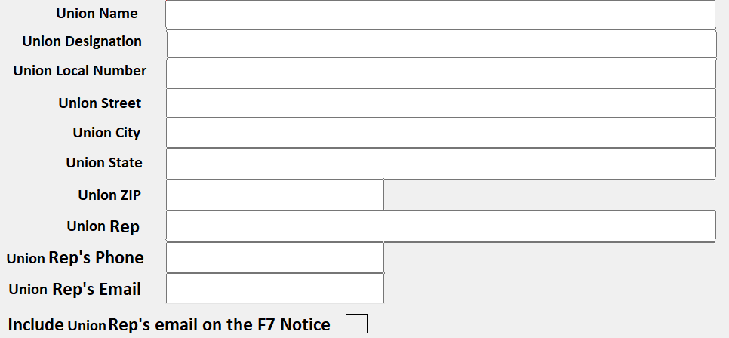
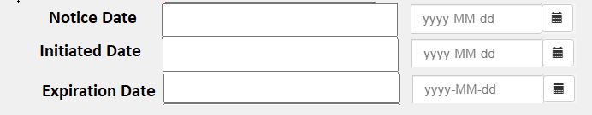
Add New Employer
The system will provide an option to manually create an employer record (if the employer is not listed in the F7 spreadsheet).

Slide 6
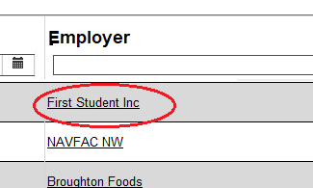
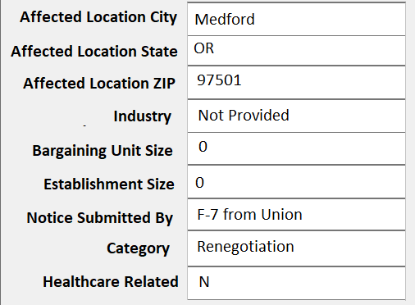
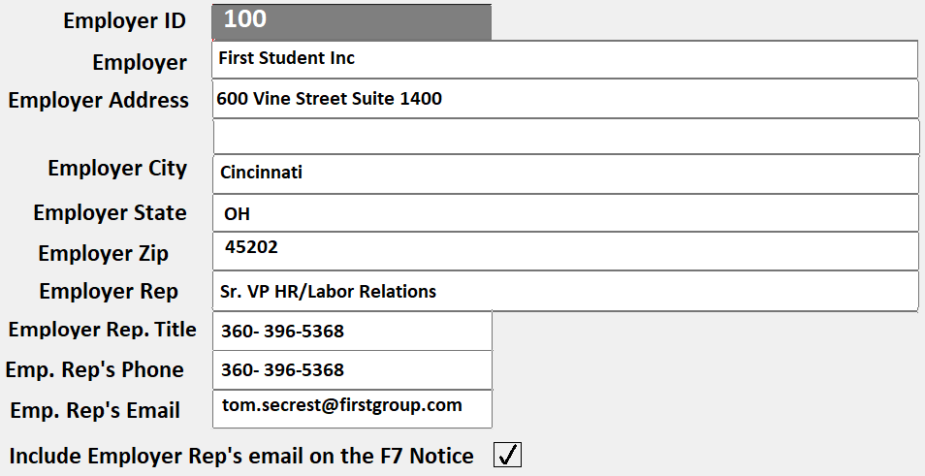
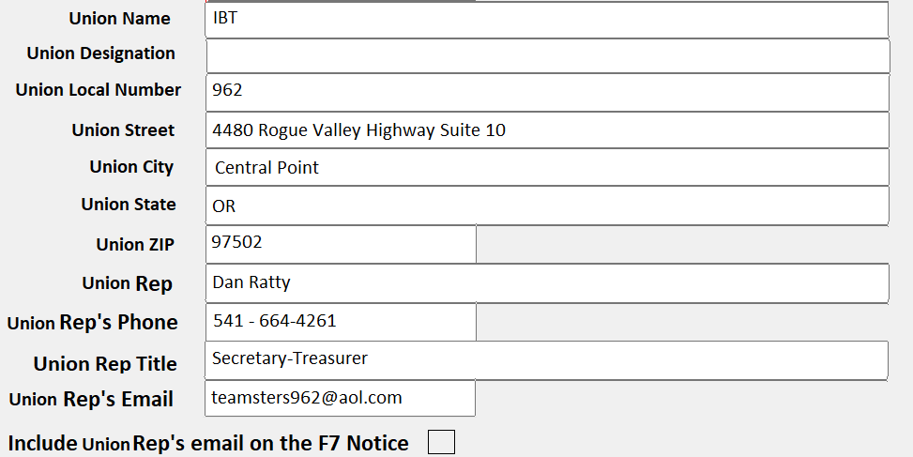
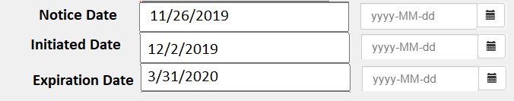
Employer Editor
The user should be able to modify the employer and the union data imported.
Selecting an employer for editing will open the employer’s details on the editor.
The user should be able to edit all except employer ID.

Slide 7
F7 Notice
The system will create F7 letter using the new template provided on 08/04/2020.
The letter will have the employer ID, employer name and address and the expiration date will be printed on the F7 letter.
The system will provide a formatting capability to edit the text listed on the letter.
The signature field will be based on user who send the email (similar to the trusteeship function where the user list will be available to select the sender and the signature.
`

Slide 8
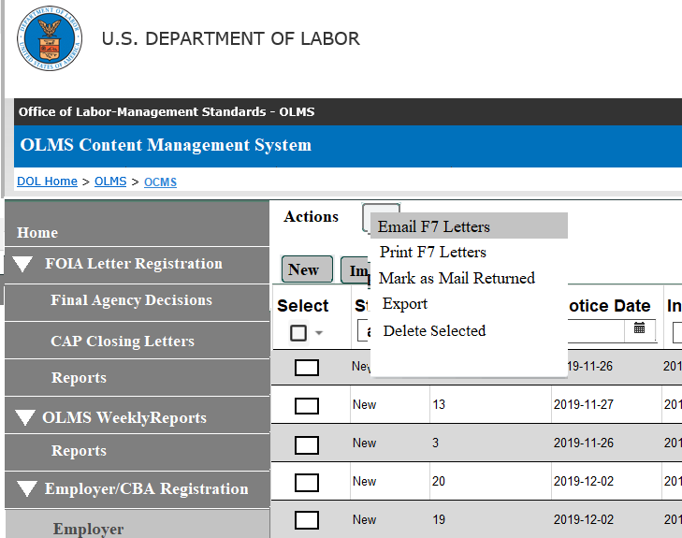
Send F7 Notifications
The system will support the following notification formats.
Email F7 letters – The system will send email to the employers who have the email address stored.
The email will have the F7 letter attached.
The status of these records will be changed to F7 Notice Sent.
The system will also track the email sent date.
An editor will be provided for changing the text of the letter’s body.
Print F7 letters – The user should be able to print the F7 letter to send by mail.
The user should be able to select all employers for sending the mail, including the ones who have an email sent.
The status of these records will be changed to F7 letter printed.
The system will also track the letter print date.
The system will track both Email Sent date and Letter printed date separately.

Slide 9
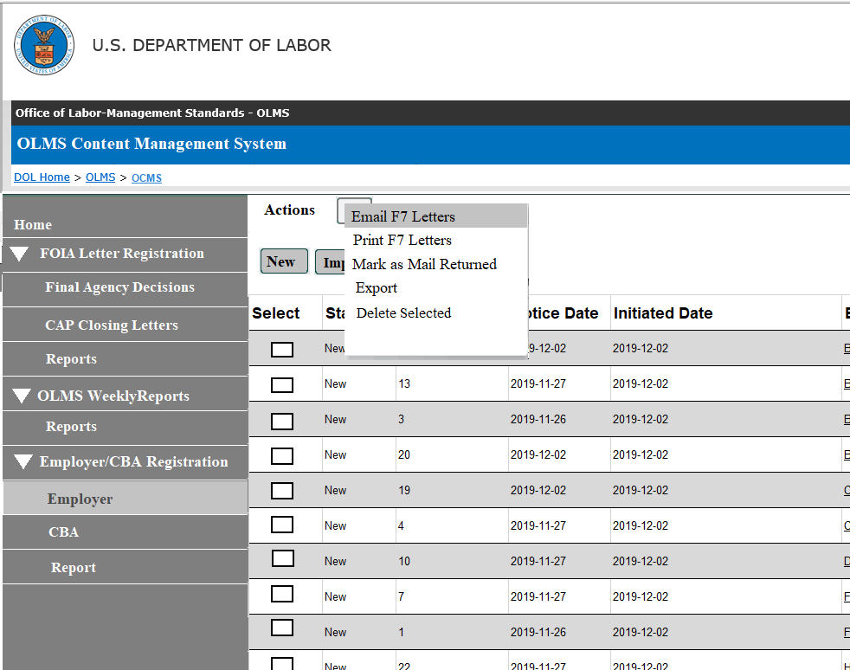
Other functions
Mark as Mail Returned – Any returned mail can be marked as undelivered using this option.
The status for those records will be Mail Returned
Export – The list can be exported to the CSV files using this option.
Delete Selected – This option will delete the selected employer record(s) permanently.
The permission to delete a record can be controlled by permission setting.

Slide 10
Receive CBA
Employers will continue to return the CBA via email or mail.
We will look into functionality to access the email received from the employer from the CBA editor.
This will help the user to add CBA details and also upload the file.

Slide 11
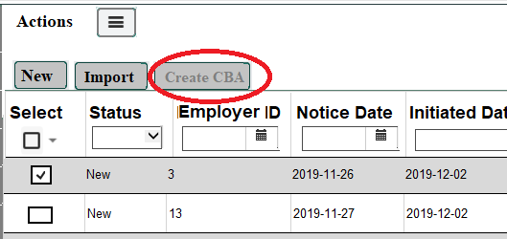
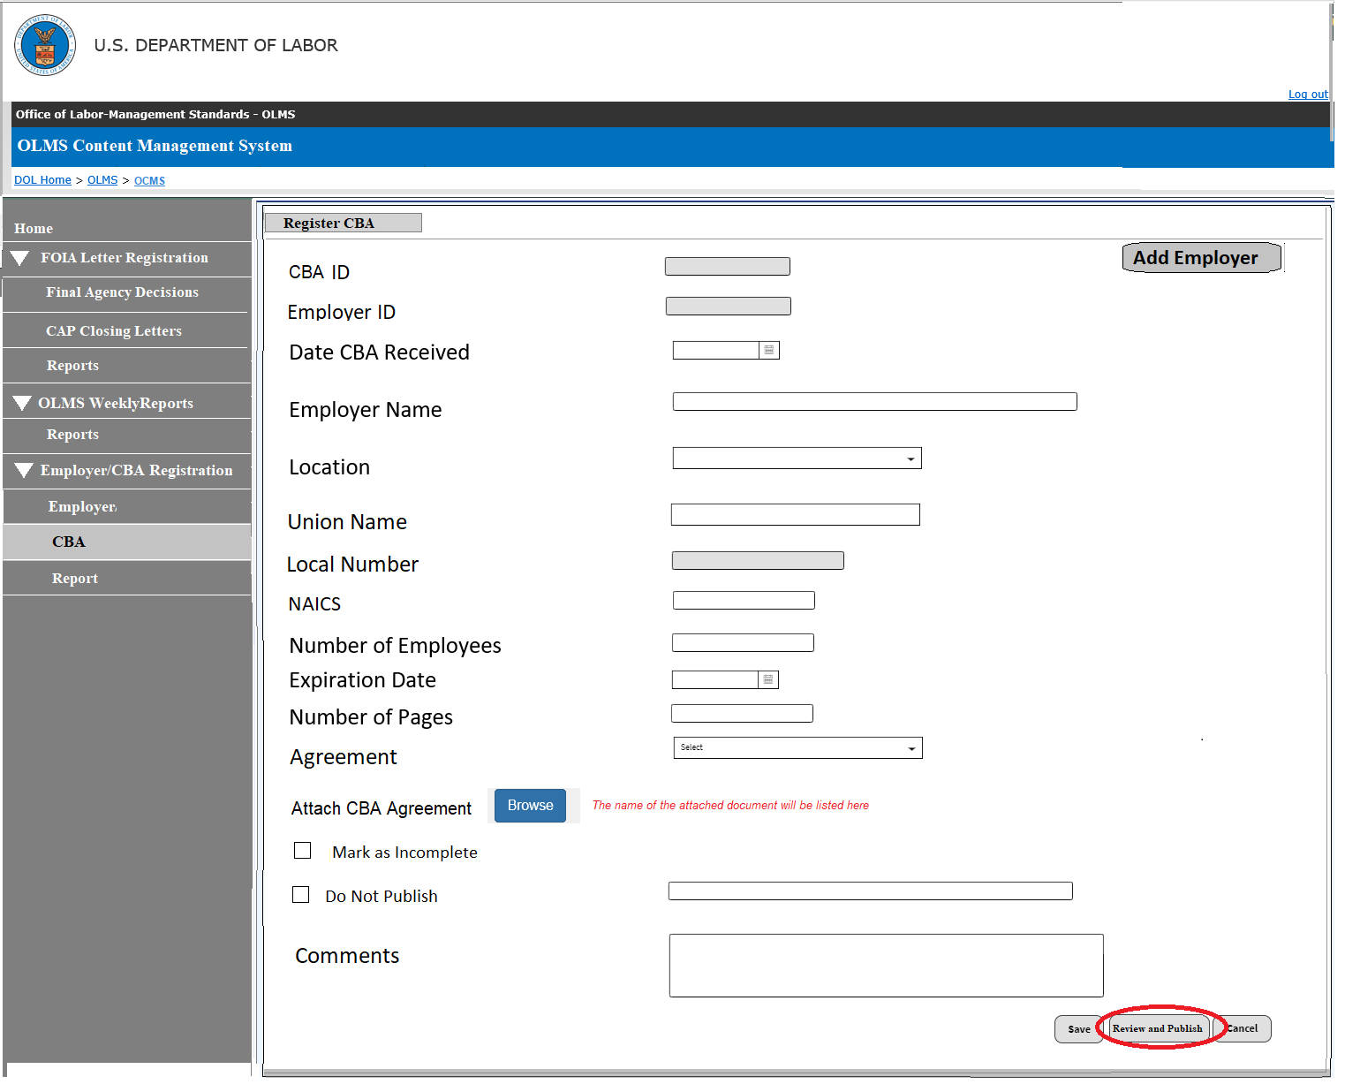
Create CBA
By selecting an employer record and clicking the Create CBA button, the system will use the employer, and the union information from the F7 notice page to create the CBA record.
The following fields will be listed in the editor:
Employer ID (populated by the system and will not be editable)
CBA ID (System generate ID upon save)
Date CBA Received
Employer Name (populated by the system and will be editable)
The system will also provide a search feature to find an existing employer
Location (populated by the system and will be editable)
Union Name (populated by the system and will be editable)
The system will also provide a search feature to find an existing union
Local Number (populated by the system and will be editable)
Search feature will populate the local number based on the union selected and will be editable)
NAICS #
Number of Employees
Expiration Date
Number of Pages
Agreement (dropdown will list Public, Private and confidential )
Do Not Publish – Checking this checkbox will stop publishing the CBA on the OPDR page. The user will have to enter a reason for not publishing the CBA on the page.
For the Confidential type , this box will be checked automatically.
Button to browse and upload the agreement file
Comment box to enter any additional information
A check box will be provided to mark a CBA as Orphan CBA.

Slide 12
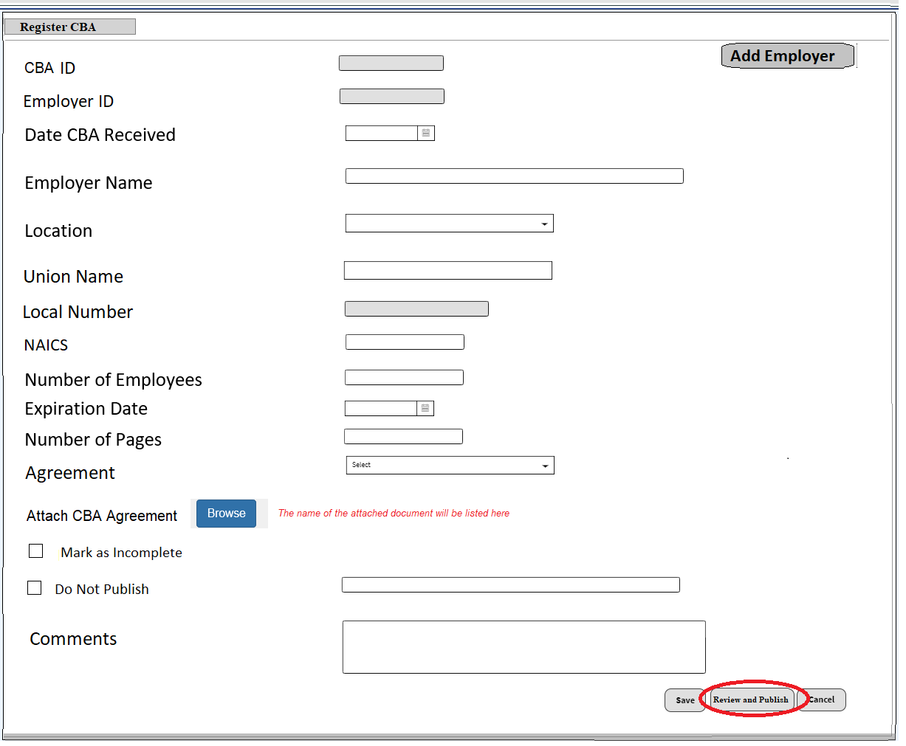
Create CBA – Multiple employers/unions
If the agreement is between multiple employers, the user will add multiple employer/union data using the the Add Employer button.
Clicking this button will provide a search feature to select and add the employer and union data.

Slide 13
Create CBA
Upon entering the required data set and save the page, the Review and Publish button will be enabled.
This button will get enabled only for the Private and Public CBAs
Confidential and Orphan CBAs will not get published; hence this button will not be enabled for those CBAs.
Clicking the Review and Publish button will open a new page displaying the data entered.

Slide 14
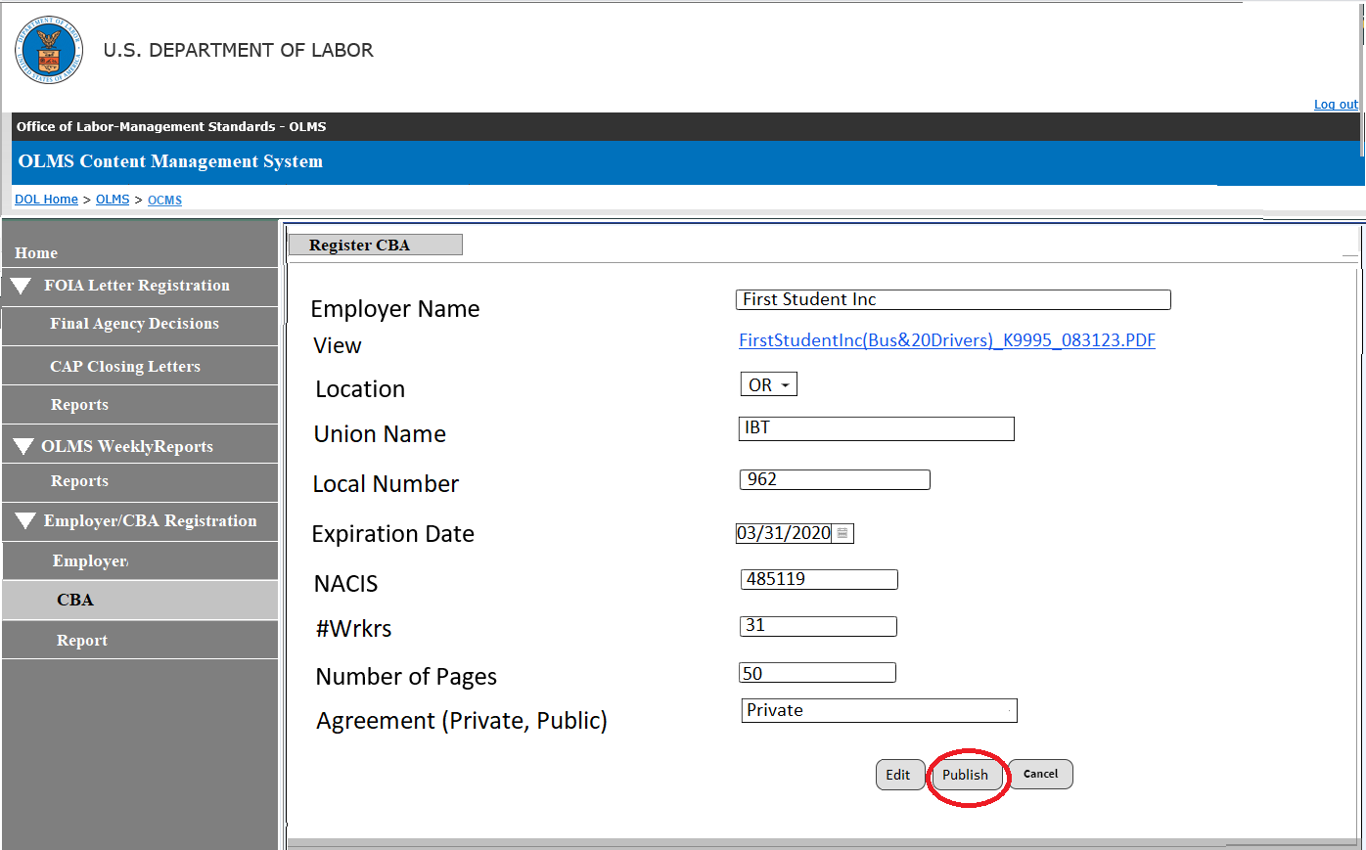
Review and Publish CBA
The review page will have a button to publish the data instantly on the OLMS disclosure page (OPDR).
The user should be able to return to the editor for any additional changes.
The data disclosed can be modified, saved, and republished.
Upon saving the CBA record, the employer page will have the status changed to CBA received.

Slide 15
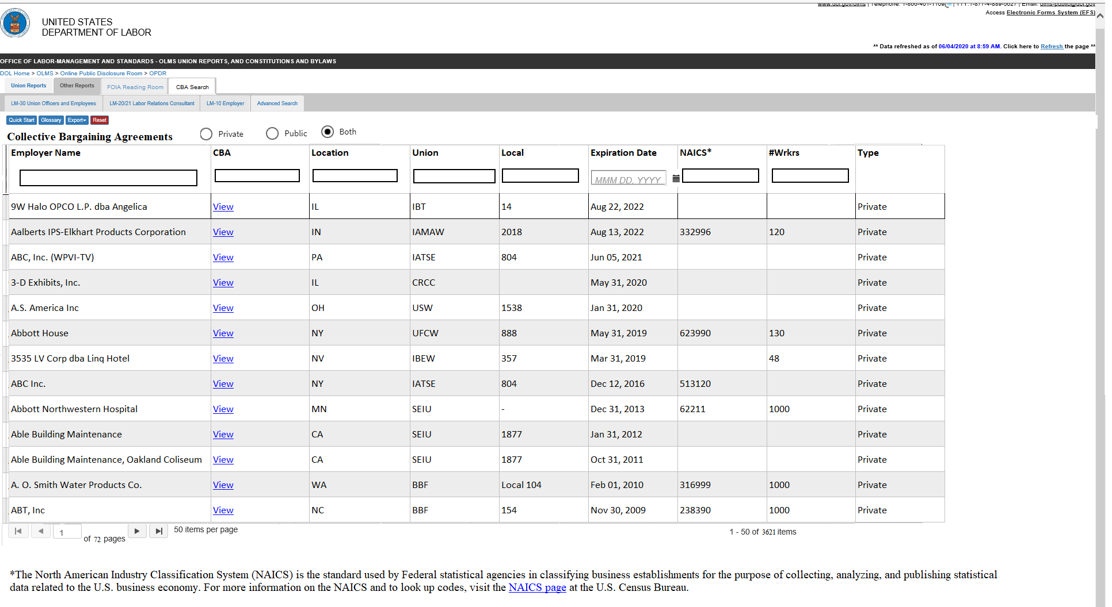
The Disclosure Page (OPDR)
Upon clicking the Publish button, the CBA data will be disclosed on the OPDR page.
The disclosure will display only the Private and Public agreements
CBAs with multiple unions will be listed with a comma or slash separator.
As per the current process, the disclosure page will continue to display expired CBAs
If the employer provides the renewed agreement, the user will register the employer again with the new CBA agreement.
The employer will get a new ID during the registration
The OPDR page will display both old and new agreements

Slide 16
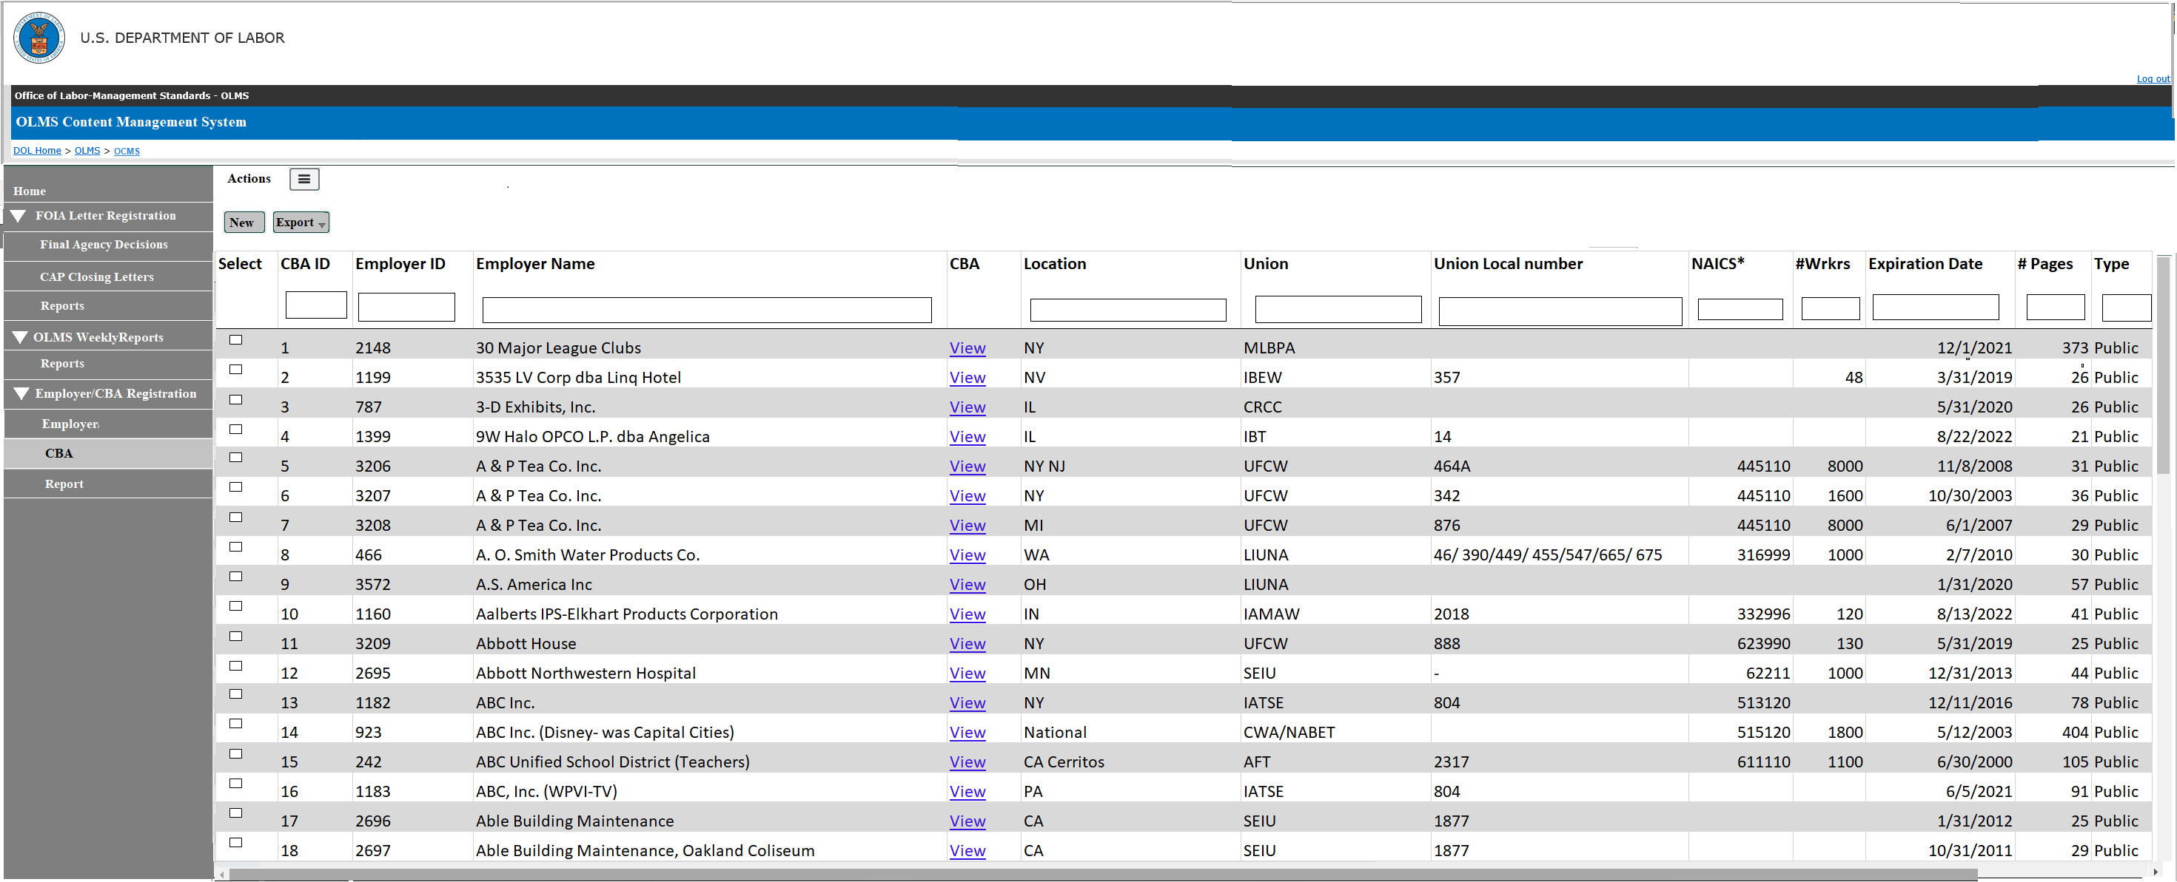
CBA Listing Page
All registered CBAs will be listed on the CBA Listing page.
The user should be able to edit and republish any CBA record.
A published CBA can be removed from the disclosure page by marked it as Do Not Publish

Slide 17
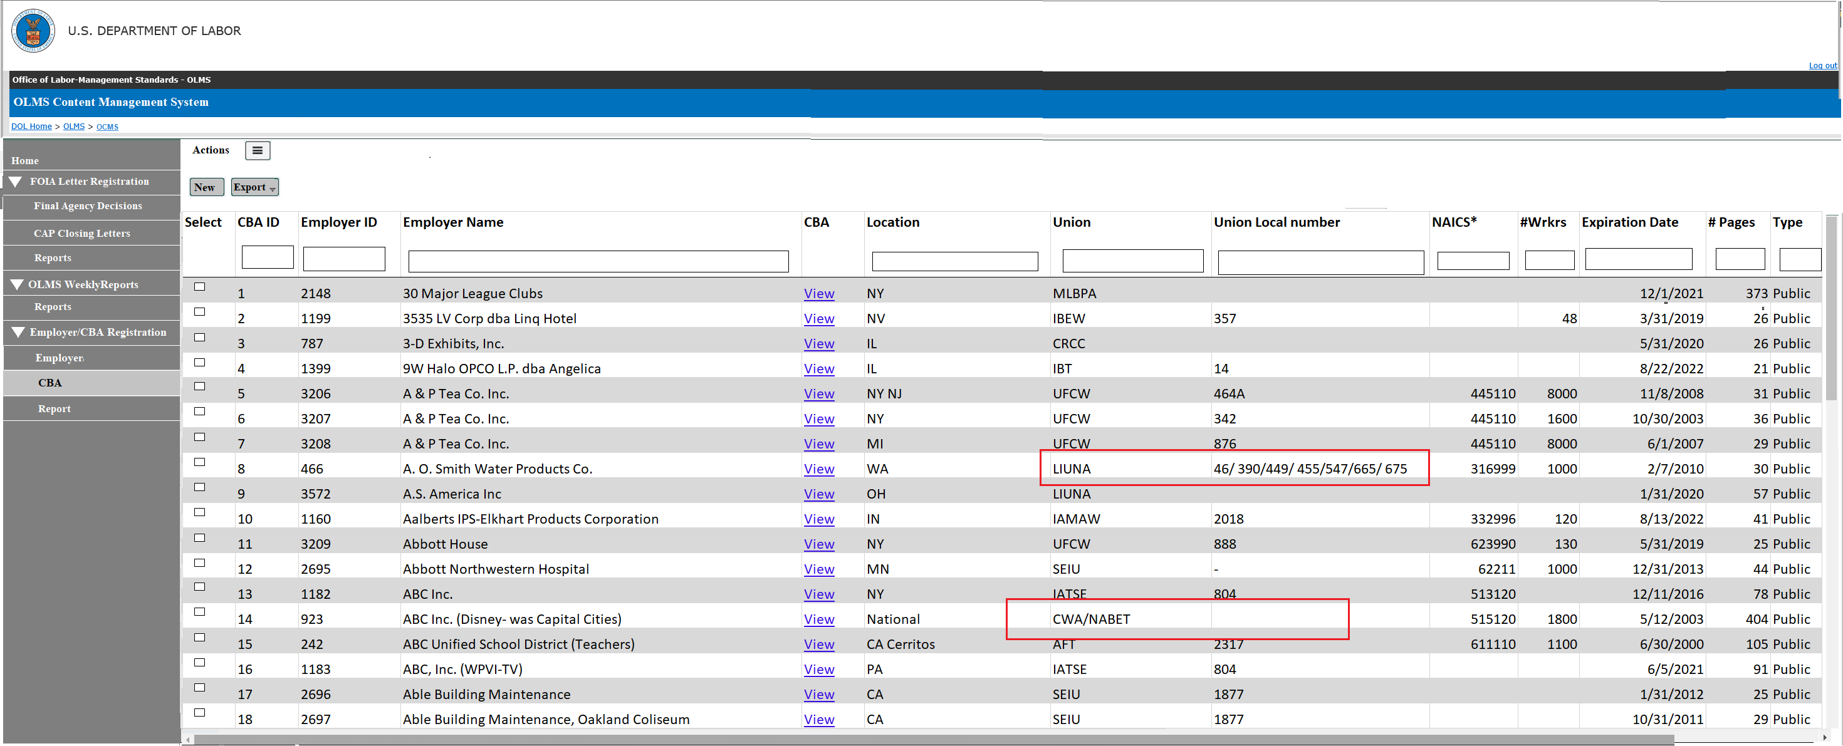
CBA Listing Page
CBAs with multiple CBAs will be listed with comma separated

Slide 18
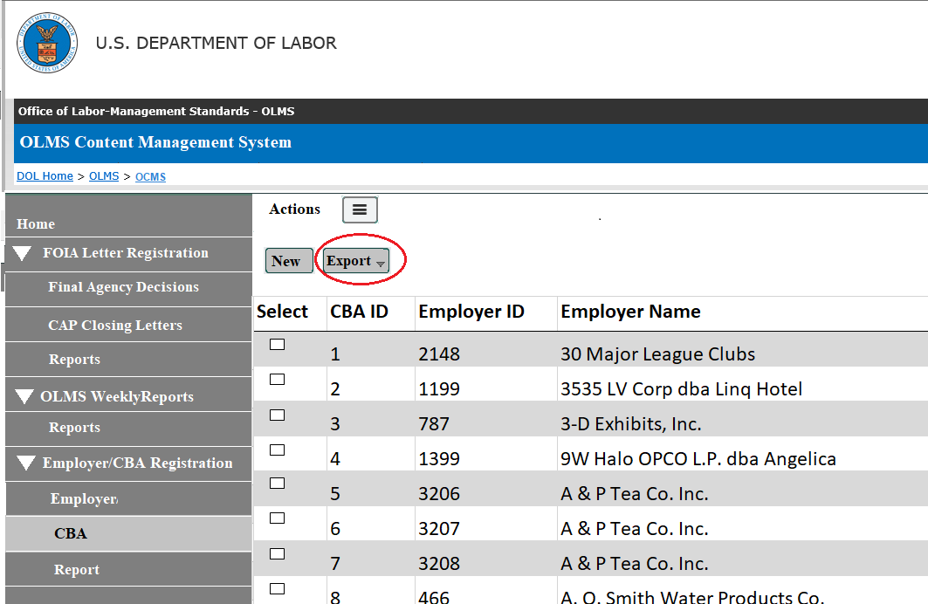
CBA Listing Page
Additional features available on this page are:
Export – The user should be able to export the list to an excel spreadsheet.
The user should be able to filter the entire list or filtered list.
Filter - Each column has column filters enabled

Slide 19
Reports
The Reports tab will have the following two types of reports:
Statistics
Counts By Month

Slide 20
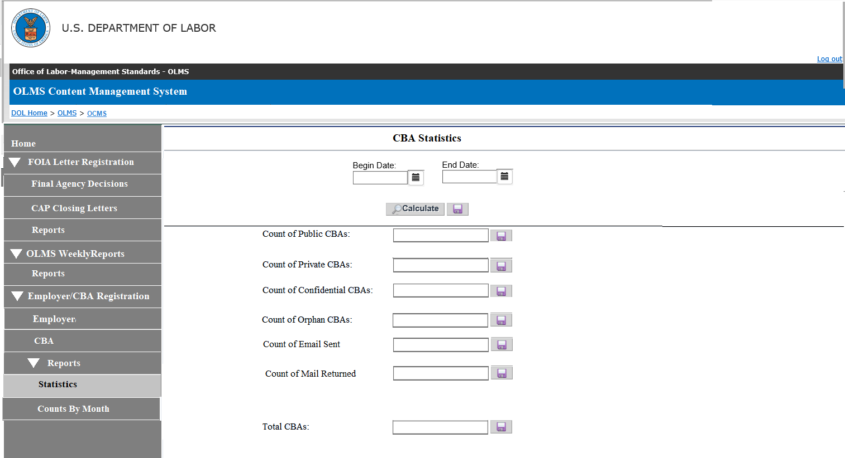
Statistics
The statistics page will list the counts of each CBA type registered during the time frame selected.
Private CBAs
Public CBAs
Confidential CBAs
Orphans
Email Sent
Mail Returned
Total counts
Also we will look into getting the duplicate CBA counts

Slide 21
Statistics - Export
The user will be able to export the data corresponding to each count to an Excel spreadsheet.
The export files will list all the following data fields.
Employer
Location
Union
Local
Expiration Date
NAICS
#Wrkrs
Type

Slide 22
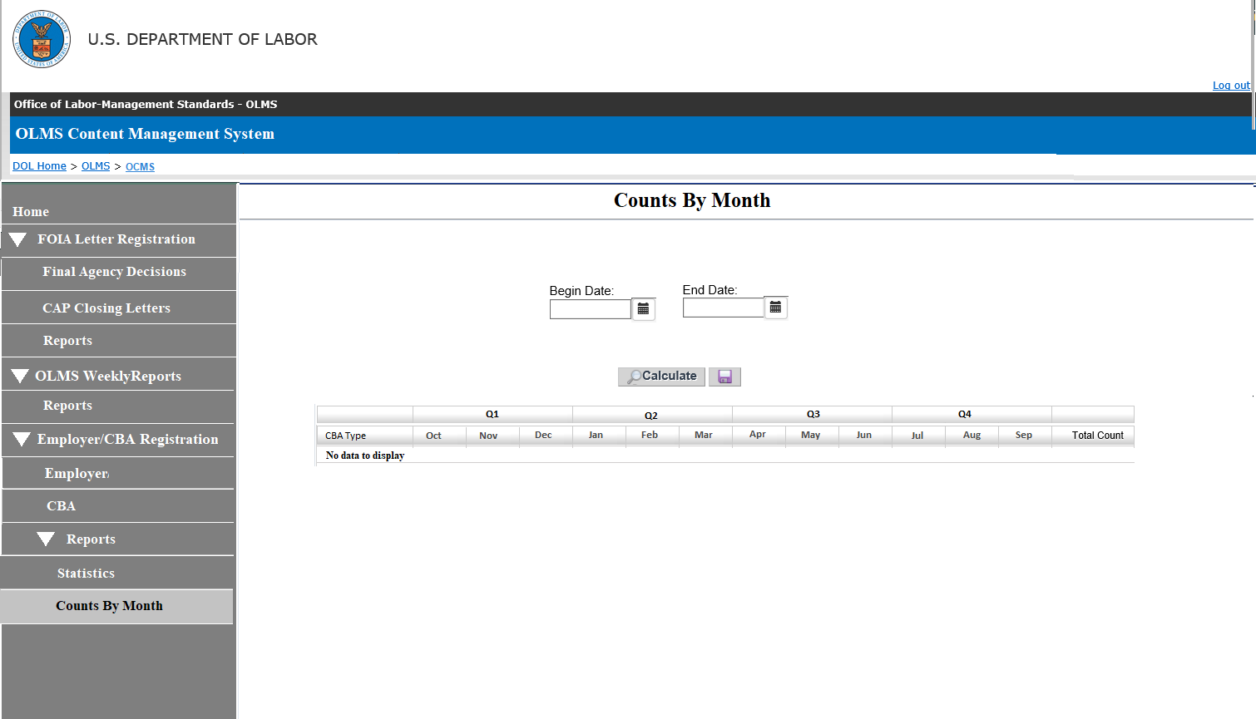
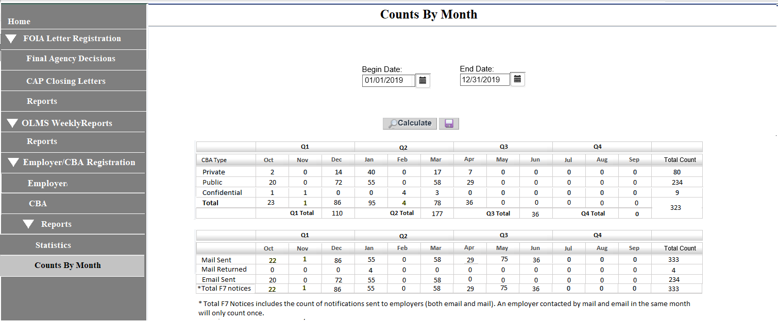
Counts By Month
The Counts By Month Report will provide a monthly registration counts of each CBA type.
Based on the Begin and End Date entered, the page lists the data by month along with the total count.
The user will be able to export this page to an Excel spreadsheet.

Slide 23
Questions?

